Slide 1


HTML & CSS

Slide 2

HTML & CSS
Languages for describing the website view
HTML - Elements of the page (text, images, content blocks…)
CSS - Design of the elements (size, spacing, colors…)

Slide 3
Let Me Show You The Matrix

Slide 4
See Others HTML & CSS
In any website you can right click on any part of the screen, and click “inspect” in the pop menu.
Dev tool will open, where you can check the HTML & CSS of the page (and also JavaScript and more..)
Web page code is public: when you load a webpage, the
browser loads HTML & CSS (and more) in the background, and presents it as a graphical view that users can understand.
Writing a website is telling the browser what to do!

Slide 5
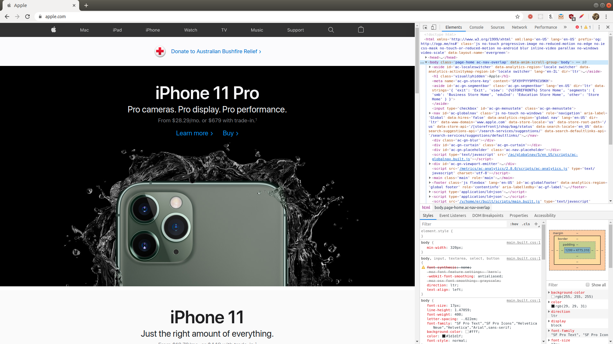

Slide 6
HTML & CSS - How It Looks
<!DOCTYPE html>
<html lang="en">
<head>
<meta charset="UTF-8">
<meta name="viewport" content="width=device-width, initial-scale=1.0">
<meta http-equiv="X-UA-Compatible" content="ie=edge">
<title>Document</title>
</head>
<body>
<div style="width: 600px; margin: 40px auto; background-color: grey;">
<img src="./my-image.jpg" alt="An image" />
<h1>Hi</h1>
<p>
This is a main website
</p>
</div>
</body>
</html>
<head> is a tag for defining metadata (data that is not presented in the page) - we will ignore it for now.
This is the style attribute (inside an HTML tag). This is where we use CSS to define styles (width, margin - spacing, background-color, etc…). CSS is written with key-value pairs, with semicolon after each pair.
Html is written with tags - <body> is the main tag where the content is
<h1> is a header tag, the text inside is the text of the header (header = text title). You can also use <h2>, <h3>, <h4> … <h6>
This is a closing tag - <body> is a tag that has content (other tags) like <h1> has content (just text), so it needs to be closing.

Slide 7
Basic HTML Tags
<html> - the main tag of the page that wraps everything
<head> - the tag that contains some metadata on the page - not shown on the page
<body> - where the page content is placed - what you want to present (text, images, blocks)
<div> - a generic tag that holds other tags, for structuring (sections, blocks etc.)

Slide 8
Some More HTML Tags
<h1>, <h2> … <h6> - a tag that holds a text, and presents it as a header text.
<p> - a tag that holds a text, and present it as a paragraph.
<img> - a tag that presents an image. Example:
<img src="./my-image.jpg" alt="An image" />
<img> is a self closing tag (has an opening tag, with / in the end). The image data (image file) is declared in the src attribute.

Slide 9
Some More HTML Tags
<a> - anchor tag, links. Holds text to present, but the link it
self goes in the href attribute. Example:
<a href="https://facebook.com">facebook</a>
There are many more tags to learn. Found a new tag? Google it to check what it does (e.g. google “ul html tag”)

Slide 10
CSS - Styling Our HTML
CSS is written in the html tags in the style attribute (data of the tag that it is not it’s content)
CSS is written in key-value pairs, separated by semicolon (;)
You can have css properties such as color, background-color, font-size, width, height, margin (for spacing) and more.
<div style="width: 600px; margin: 40px auto; background-color: grey;">
...
</div>
This is a div tag with a width of 600px, margin (spacing) of 40px top and bottom, and a grey background

Slide 11
Recap
Open HTML tag
<some-html-tag style="color: black; font-size: 24px;">
...
</some-html-tag>
Content (text or other tags)
Attribute - css style attribute with key: value; pairs
Close HTML tag

Slide 12
CSS - Styling Our HTML
Entire CSS property list: https://www.w3schools.com/cssref/default.asp

Slide 13
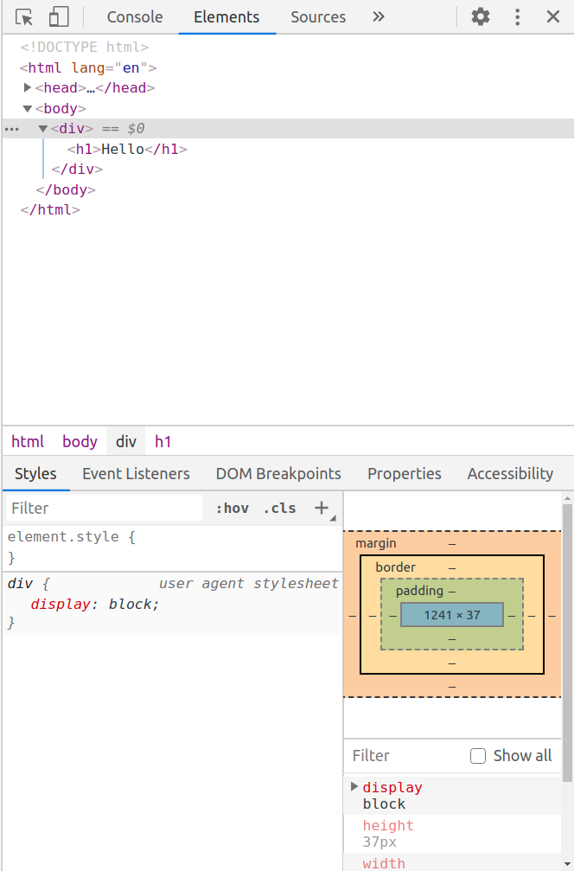
Tag Default Style
Every HTML tag has a default style properties, coming from the browser
In this case, the div tag has a default “display” property set to “block”
When writing styles, you add additional properties, or override existing ones

Slide 14
Display CSS property
<div> tags has a default display property of “block”
That means that they start in a beginning of a row, and end at the end of the row, letting no other elements to be at the same row as they
Also <h1-6>, and p tags have the same default display property
You will see no user agent style (default browser style) of display for <span>, <img>, <a> and other tags, so they have display “inline”

